Slide 1

Geometry
Unit 12, Lesson 9 Graphing Circles Volume 2, pg. 272

Slide 2


Benchmark
MA.912.GR.7.3
Graph and solve mathematical and real-world problems that are modeled with an equation of a circle. Determine and interpret key features in terms of context.
volume 2, pg. 272

Slide 3
Integrated Mathematical Thinking and Reasoning Standards
MA.K12.MTR.5.1 Use patterns and structure to help understand and connect mathematical concepts.
MA.K12.MTR.7.1 Apply mathematics to real-world contexts.
volume 2, pg. 272

Slide 4

Learning Targets
I can graph a circle and determine its key features when given an equation of a circle.
I can solve mathematical and real-world problems that are modeled with an equation of a circle.
volume 2, pg. 272

Slide 5

Warm-Up
volume 2, pg. 273

Slide 6
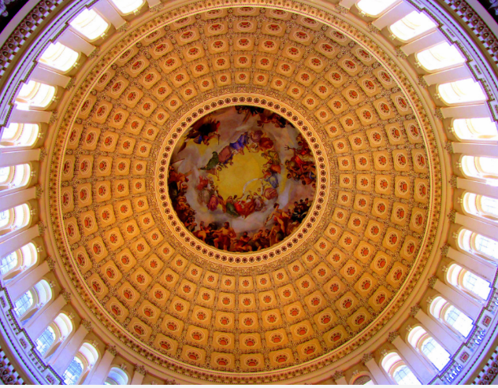
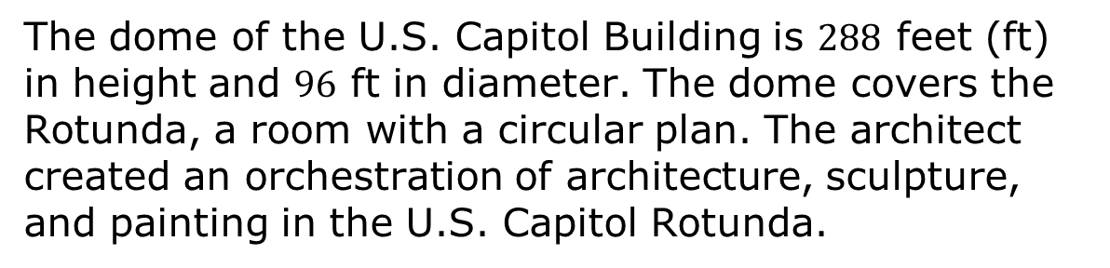
12.9.1 Warm-Up: Notice and Wonder
The dome of the U.S. Capitol Building is $288$ feet (ft) in height and $96$ ft in diameter. The dome covers the Rotunda, a room with a circular plan. The architect created an orchestration of architecture, sculpture, and painting in the U.S. Capitol Rotunda.
What do you notice?
What do you wonder?
volume 2, pg. 273

Slide 7

Guided Practice
volume 2, pg. 273

Slide 8

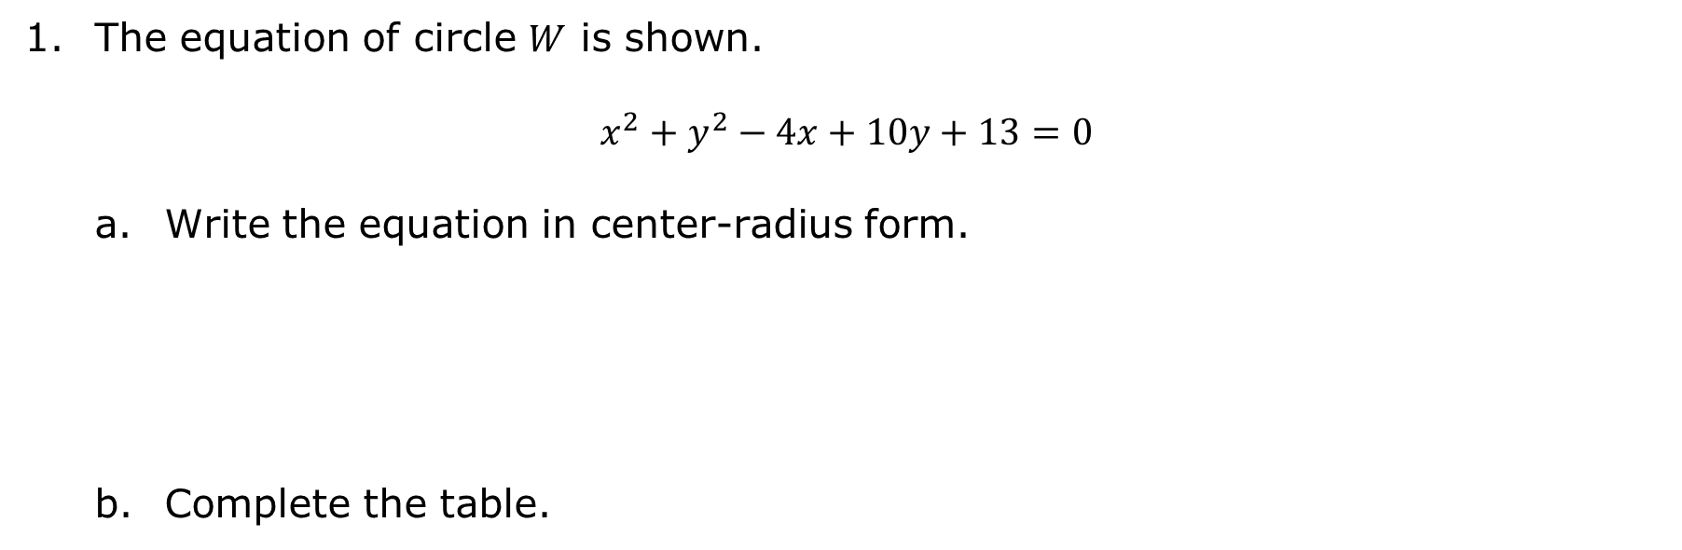
12.9.2 Guided Practice: Graphing Circles
The equation of circle $W$ is shown.
$$x^{2}+y^{2}−4x+10y+13=0$$
Write the equation in center-radius form.
Complete the table.
Center | Radius
volume 2, pg. 273

Slide 9
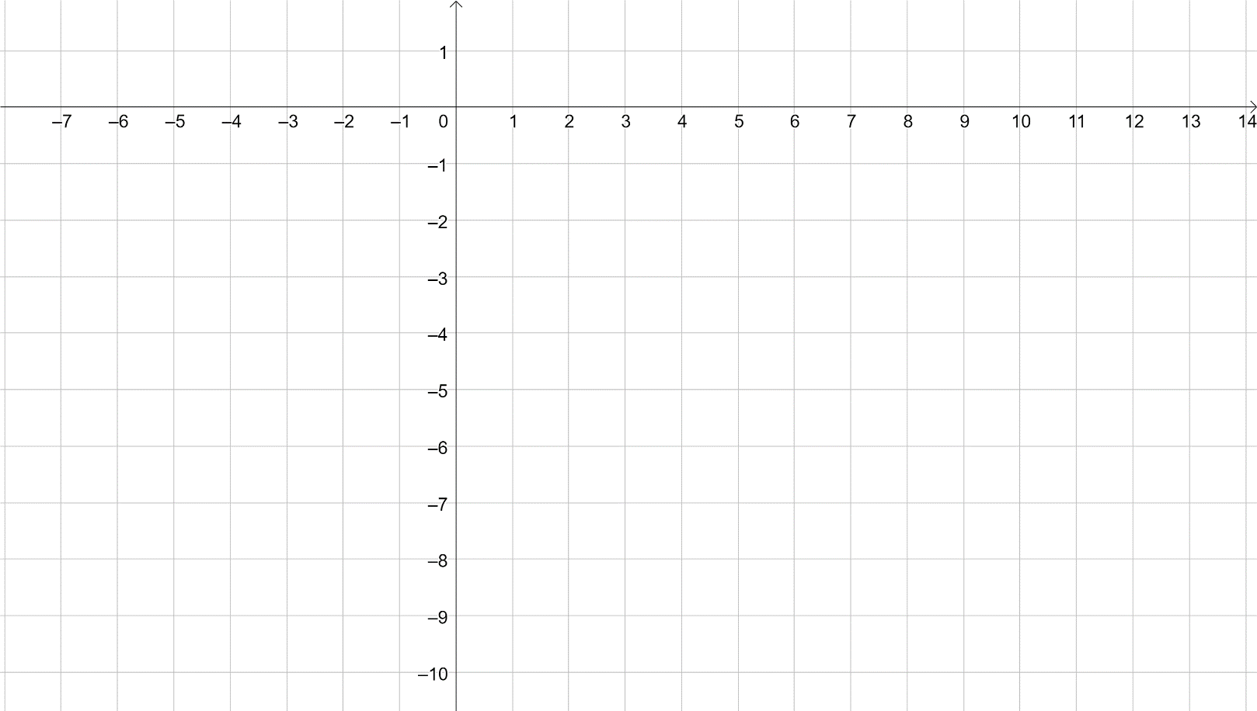
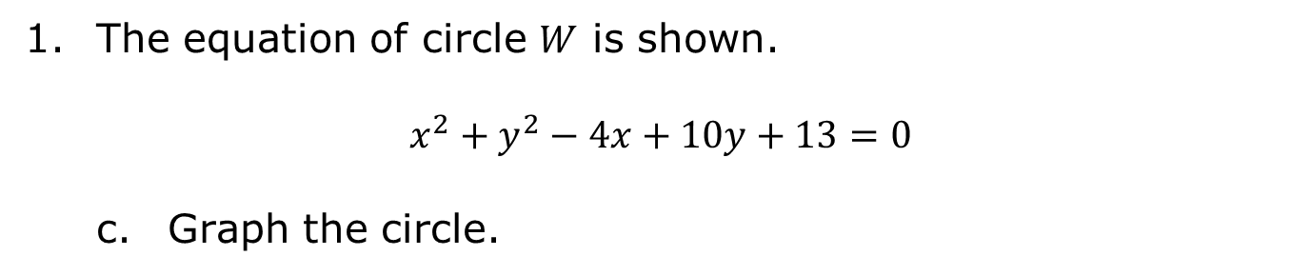
The equation of circle $W$ is shown.
$$x^{2}+y^{2}−4x+10y+13=0$$
Graph the circle.
volume 2, pg. 273

Slide 10
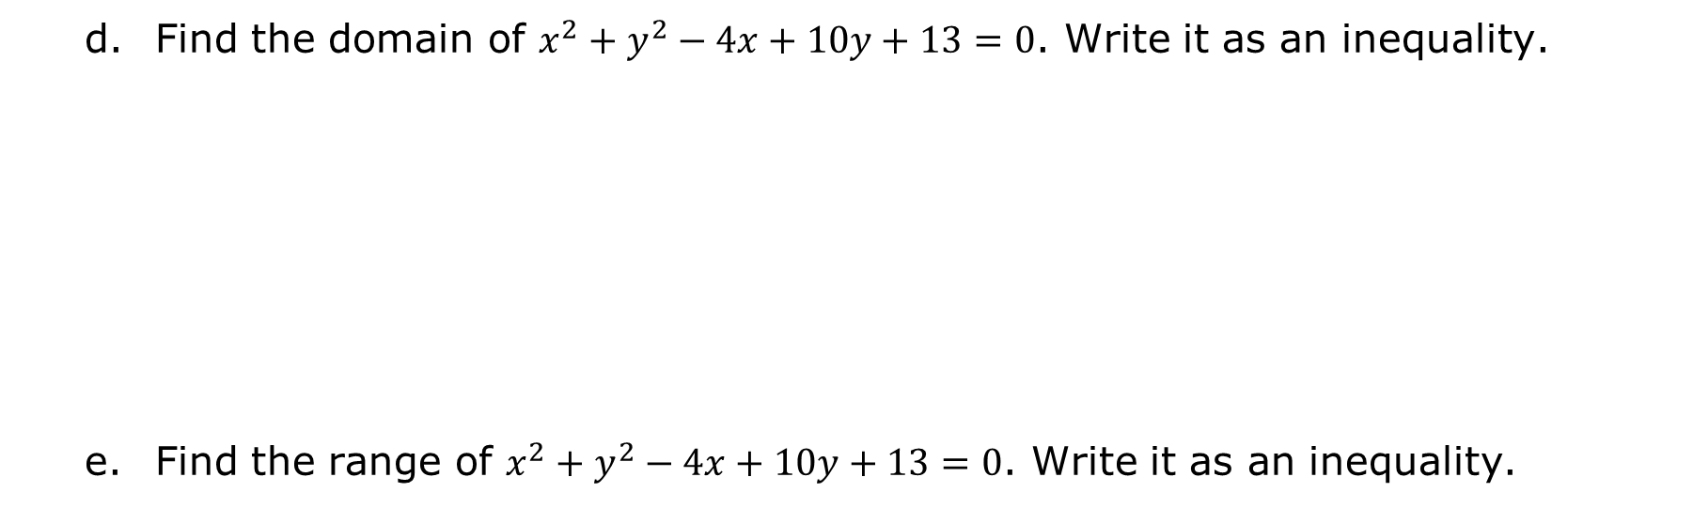
Find the domain of $x^{2}+y^{2}−4x+10y+13=0$. Write it as an inequality.
Find the range of $x^{2}+y^{2}−4x+10y+13=0$. Write it as an inequality.
volume 2, pg. 274

Slide 11
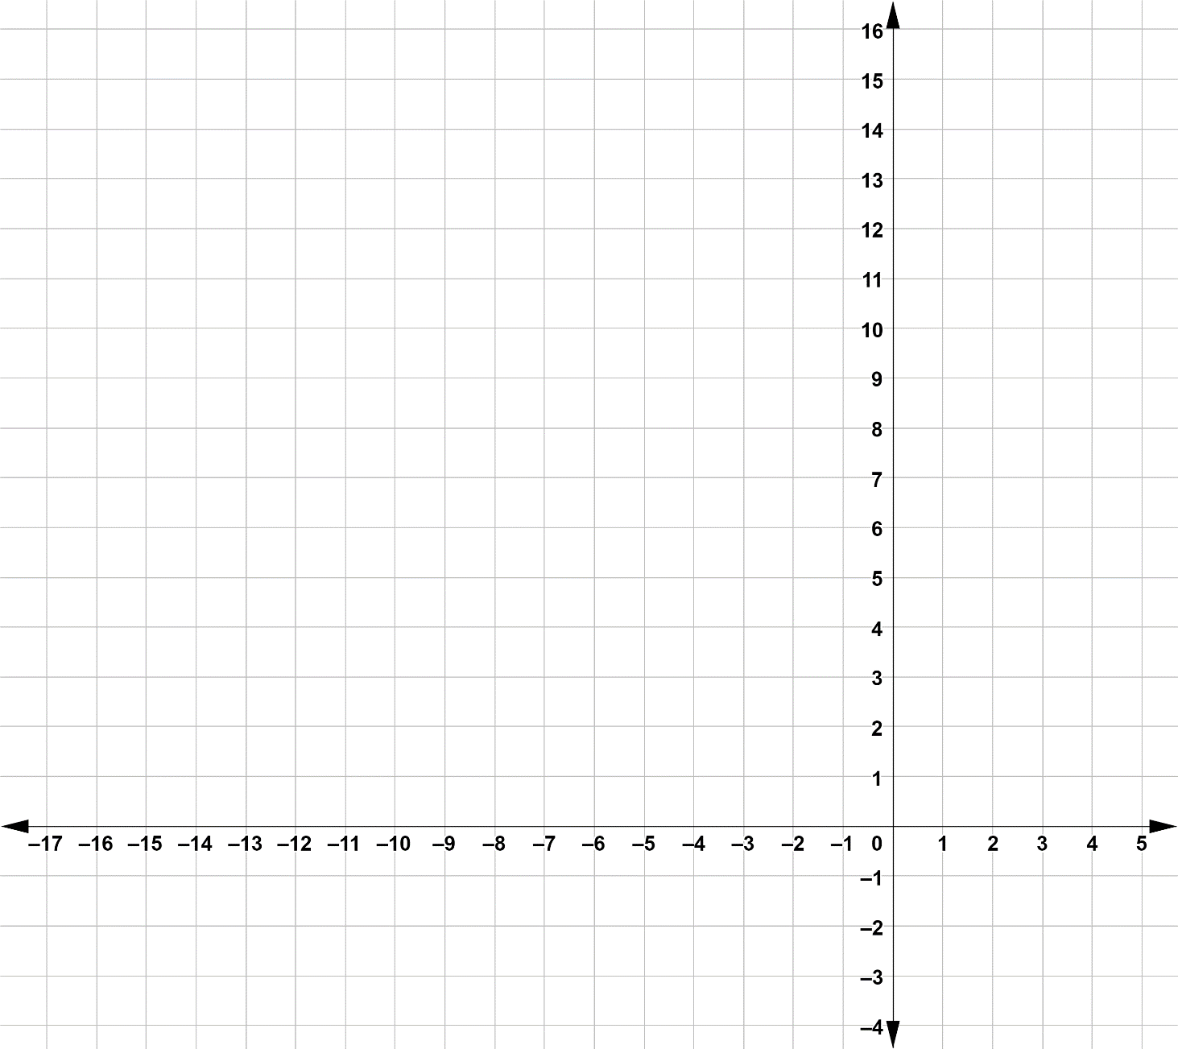
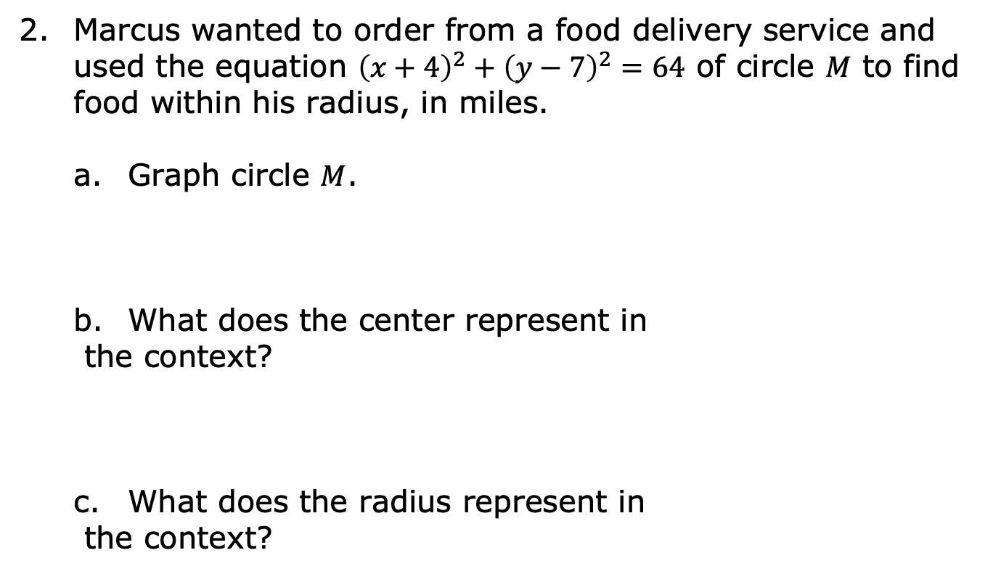
Marcus wanted to order from a food delivery service and used the equation ${\left(x+4\right)}^{2}+{\left(y−7\right)}^{2}=64$ of circle $M$ to find food within his radius, in miles.
Graph circle $M$.
What does the center represent in
the context?
c. What does the radius represent in
the context?
volume 2, pg. 274

Slide 12
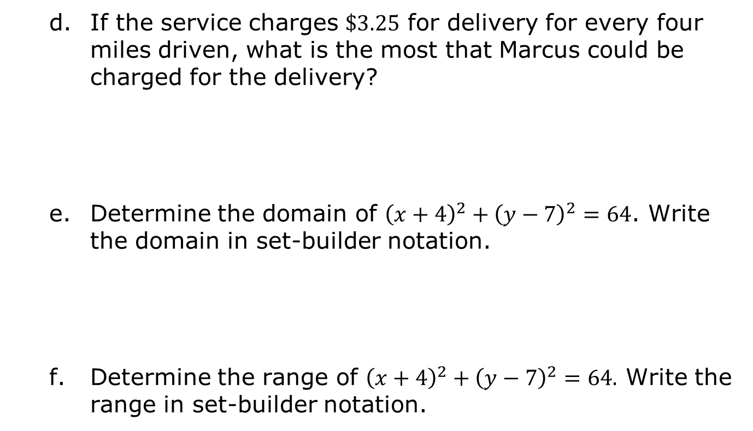
If the service charges $\$3.25$ for delivery for every four miles driven, what is the most that Marcus could be charged for the delivery?
Determine the domain of ${\left(x+4\right)}^{2}+{\left(y−7\right)}^{2}=64$. Write the domain in set-builder notation.
Determine the range of ${\left(x+4\right)}^{2}+{\left(y−7\right)}^{2}=64.$ Write the range in set-builder notation.
volume 2, pg. 274

Slide 13
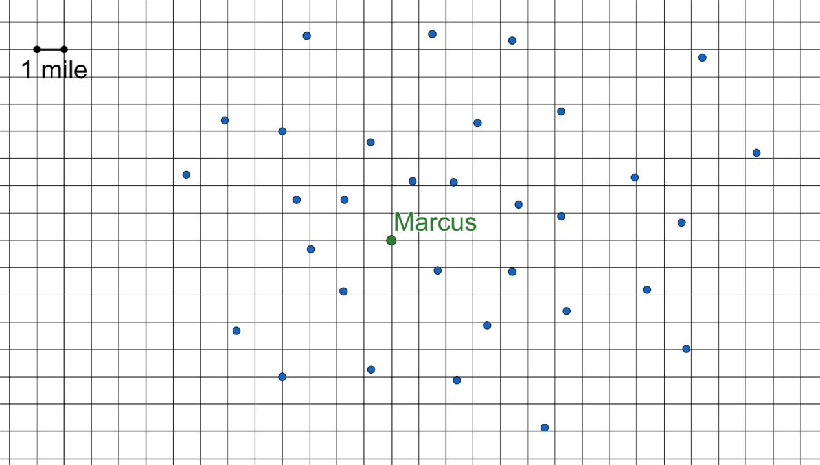
The grid shows Marcus’ location in green. The blue dots are the locations of restaurants that deliver using UberEats. Use the grid to demonstrate how Marcus could use the domain and range to determine which restaurants he can order from.
volume 2, pg. 275

Slide 14

Your Turn
volume 2, pg. 275

Slide 15
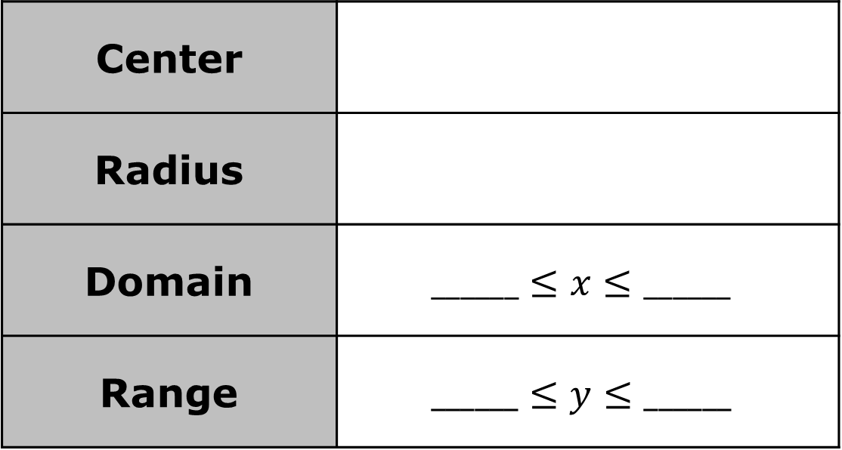
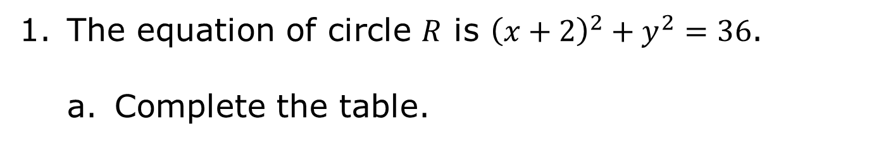
12.9.3 Your Turn!
The equation of circle $R$ is ${\left(x+2\right)}^{2}+y^{2}=36$.
Complete the table.
Center
Radius
Domain | $$______≤x≤______$$
Range | $$______≤y≤______$$
volume 2, pg. 275

Slide 16
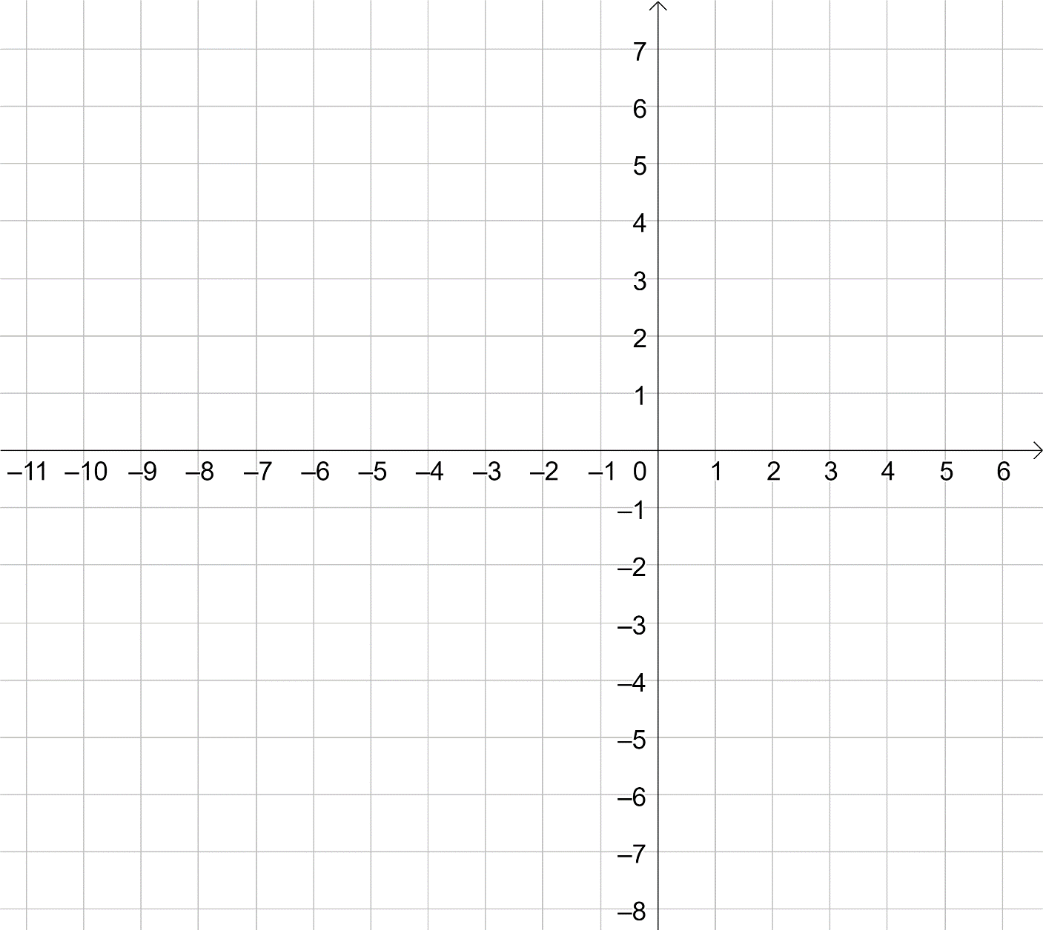
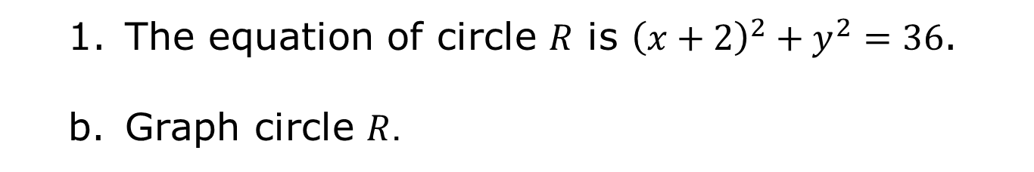
The equation of circle $R$ is ${\left(x+2\right)}^{2}+y^{2}=36$.
Graph circle $R$.
volume 2, pg. 275

Slide 17
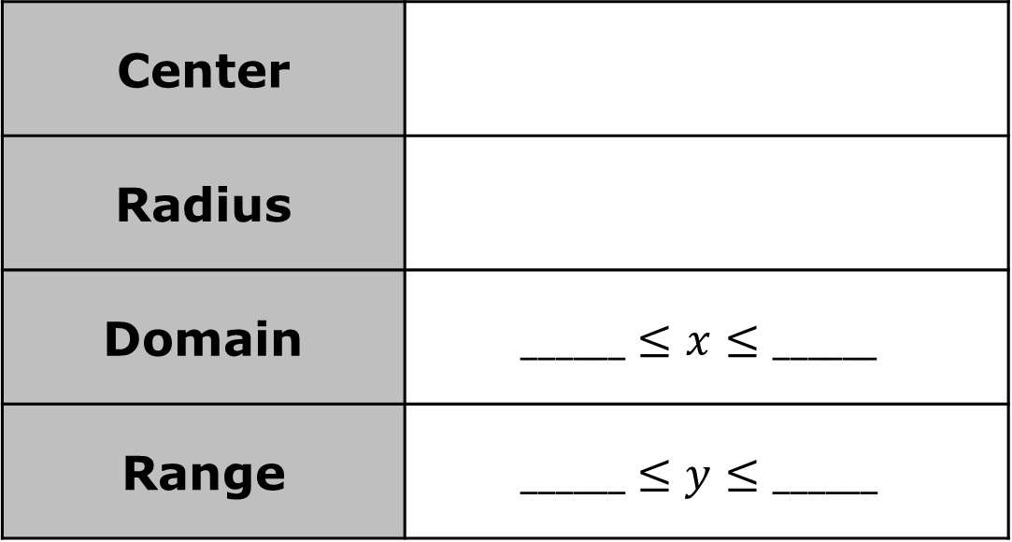
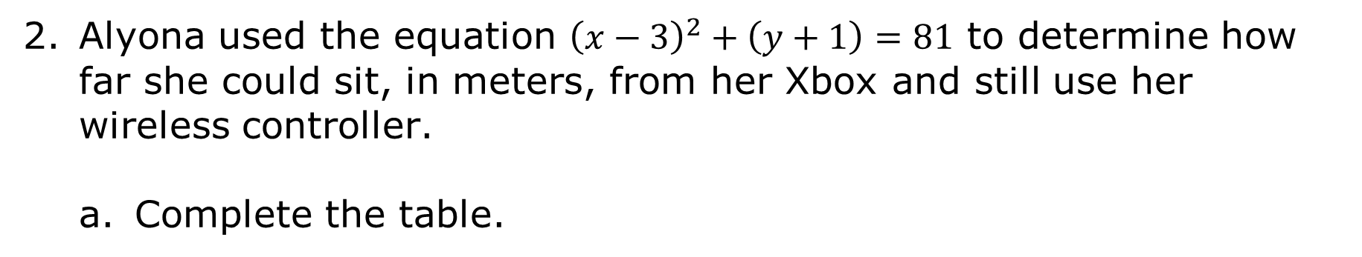
Alyona used the equation ${\left(x−3\right)}^{2}+\left(y+1\right)=81$ to determine how far she could sit, in meters, from her Xbox and still use her wireless controller.
Complete the table.
Center
Radius
Domain | $$______≤x≤______$$
Range | $$______≤y≤______$$
volume 2, pg. 276

Slide 18
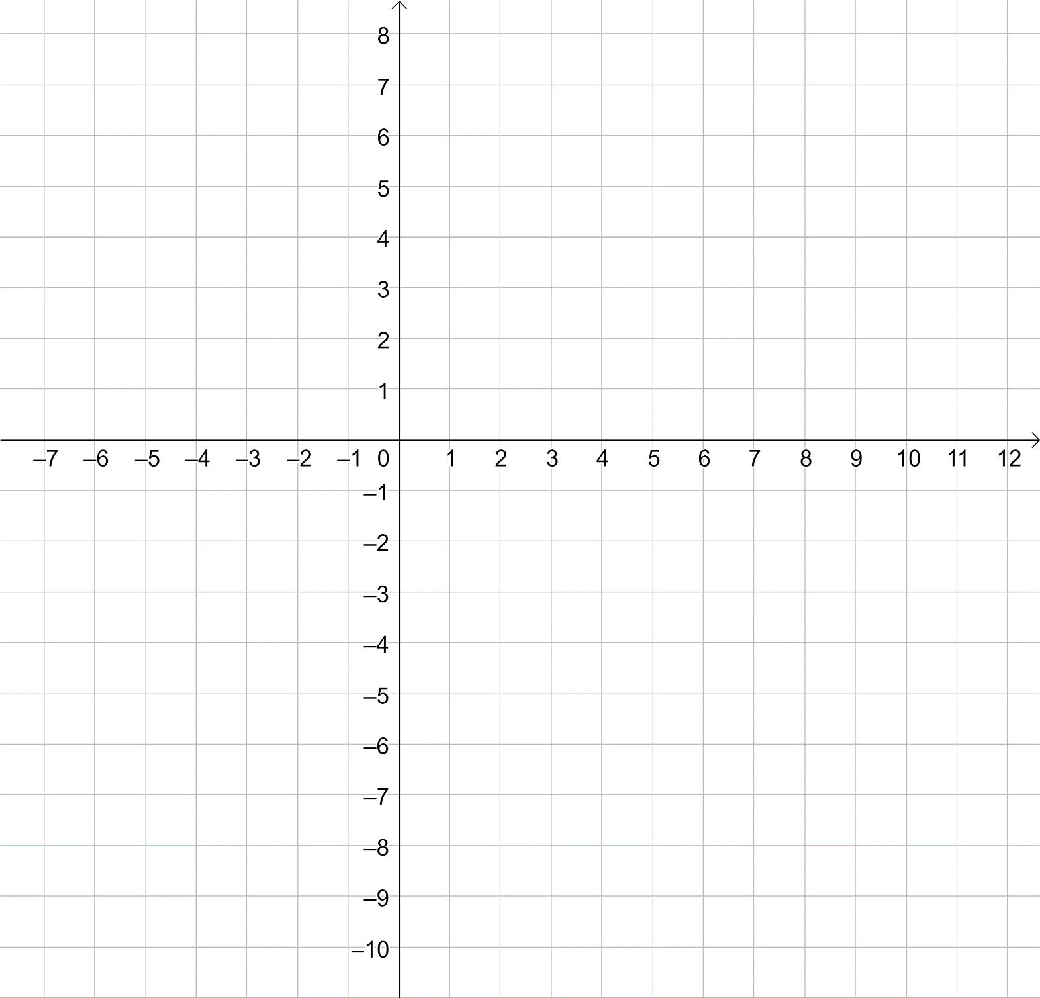
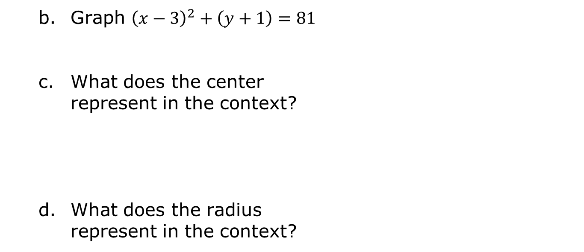
Graph ${\left(x−3\right)}^{2}+\left(y+1\right)=81$
What does the center represent in the context?
What does the radius represent in the context?
volume 2, pg. 276

Slide 19
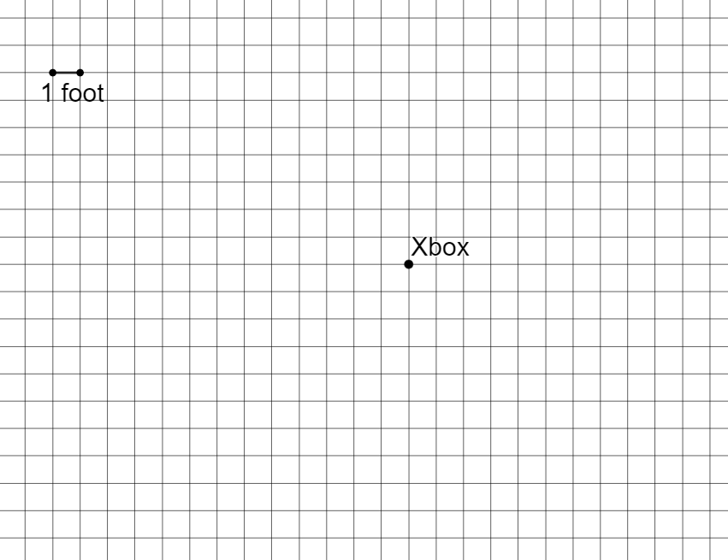
e. The grid shows the location of Alyona’s Xbox. Use the domain and range to show all of the locations at which Alyona can sit.
volume 2, pg. 276

Slide 20

Wrap-Up
volume 2, pg. 277

Slide 21
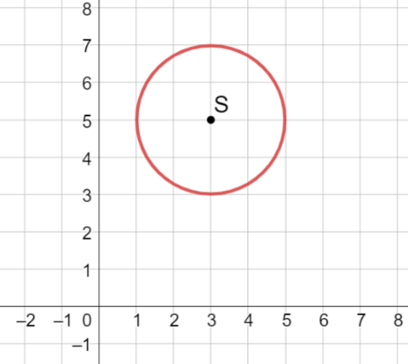
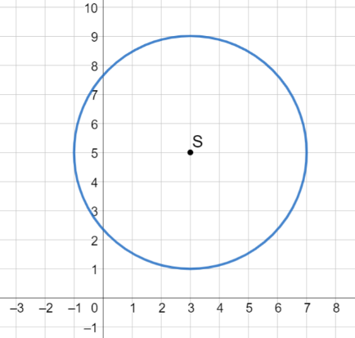

12.9.4 Wrap-Up: Error Analysis
Ziquan and Amber both graphed circle $S$, ${(x−3)}^{2}+{\left(y−5\right)}^{2}=4$, but their circles looked different.
Who correctly graphed circle $S$?
Write a note to the person who graphed circle $S$ incorrectly explaining their mistake.
Ziquan’s Circle | Amber’s Circle
volume 2, pg. 277

